Slide 1

The Effect of Tariffs on Global Imports and Exports
Srinath M Krishnan (smk220008)
Jashank Kshirsagar (jsk230000)
Jastej Singh Grover (jxg220032)
Lasya Bodapati (lxb230008)
Manasseh Jesrun Kota (mxk230047)
Yan Zhu(yxz230017)
Itoshi Yanazawa (ixy220002)
Sai Chandra Lekha Karanam (sxk220342)
Yash Jitendra Patil (yxp220028)

Slide 2

Introduction

Slide 3

Understanding Tariffs
Tariffs are taxes or duties imposed on imported goods and services.
They are designed to make imported goods more expensive and less competitive compared to domestic products.
Tariffs can shield domestic industries from foreign competition by raising the cost of imported goods.
Purpose of Tariffs
Tariffs are used to protect domestic industries, raise government revenue, and address trade imbalances.
In some cases, tariffs are imposed for national security reasons. Certain industries, such as defense or critical infrastructure, may be considered vital to national security, and tariffs can be used to safeguard these industries from foreign competition or control.
Notes:
Tariffs protect local industries and boost government revenue by increasing the cost of imported goods, FOR EXAMPLE, when the US imposed tariffs on steel and aluminum imports in 2018.
They're also used to safeguard vital sectors like defense and infrastructure, ensuring national security interests.
Yet, tariffs can trigger trade tensions, necessitating careful consideration to avoid escalation and maintain stable global trade relations.

Slide 4

The Research Question
How have export and import tariffs impacted the value and composition of international trade over the last 20 years (2002-2021)?
The Objective? To analyze the influence of global export and import tariffs on trade dynamics in developed and developing countries, specifically examining their effects on export and import values in terms of US dollars.
Notes:
Understanding the relationship between tariffs and trade flows are important because they inform policymakers about the consequences of tariff regimes and they can also provide insights for businesses navigating global markets
Trade is a cornerstone of economic activity globally, and tariffs are a key determinant of trade flows. By investigating the relationship between tariff-related variables and trade outcomes, we can better understand the economic implications of trade policy decisions.

Slide 5



Impact of Tariffs on Import and Export
Historical Perspective
Trade Wars: Tariffs can lead to retaliatory measures and trade wars between countries, impacting global trade.
Bilateral Trade Agreements: Tariffs influence the dynamics of bilateral trade agreements and can lead to renegotiations.
Economic Consequences
Trade Diversion: Tariffs may divert trade from one country to another, impacting the balance of imports and exports.
Consumer Welfare: Tariffs can affect consumer welfare by influencing the availability and prices of imported goods.
Long-Term Effects
Industry Competitiveness: Tariffs can shape the competitiveness of domestic industries over time.
Global Supply Chains: Tariffs influence global supply chains and can lead to shifts in sourcing and production locations.
Notes:
Tariffs can lead to significant changes in global trade. They can provoke trade wars, influence the terms of trade agreements, and cause shifts in trade from one country to another. Moreover, tariffs impact consumer prices and can reshape entire industries and global supply chains.

Slide 6


Types of Tariffs
Applied Harmonized System Tariffs
The tariffs applied to imports and exports of goods by a country, based on the Harmonized Commodity Description and Coding System.
The Harmonized System is an internationally standardized system for classifying traded products, developed and maintained by the World Customs Organization.
Most Favored Nation Tariffs
Most Favored Nation (MFN) tariffs are tariffs applied by a country to imports from all other countries at the same rate, without discrimination, a fundamental tenet of the World Trade Organization
Under the MFN principle, if a country grants a tariff concession to one trading partner, it must extend the same concession to all other WTO members to ensure that countries do not engage in discriminatory trade practices.
Notes:
There are various types of tariffs, but today we'll focus on two main types: Applied Harmonized System Tariffs and Most Favored Nation Tariffs. These tariffs are crucial in understanding how countries manage their trade policies and maintain fairness in trade practices

Slide 7

Literature Review

Slide 8
Literature Review
A) To What Extent are Tariffs Offset by Exchange Rates?(Olivier Jeanne, Jeongwon son) - August 2020
Research Approach:- The paper presents a model showing that tariffs impact the supply and demand for goods, and exchange rate movements arise as central banks manage inflation. The model also suggests that tariffs imposed by the US in 2018-19 may have affected the dollar's value.
Conclusion:- The paper concludes that tariffs affect exchange rates, but the impact varies by country. US tariffs had a significant impact on the renminbi, but less so on the dollar. The study emphasizes the need to consider exchange rate movements when evaluating tariffs' economic effects.
B) The Macroeconomic Consequences of Import Tariffs and Trade Policy Uncertainty
(Lukas Boer and Malte Rieth) - January 2024
Research Approach:- The study uses theoretical models and statistical analysis (SVAR) to assess the impact of tariff and trade policy uncertainty shocks, using specific guidelines to distinguish between these effects.
Conclusion:- The paper concludes that stable free trade relations lead to significant economic gains. It also stresses the importance of focusing on tariff levels rather than trade policy uncertainty.
Notes:
1. To What Extent are Tariffs Offset by Exchange Rates?: This paper examines how tariffs impact the supply and demand for goods and how exchange rates respond. It finds that tariffs can affect exchange rates, but the impact varies by country.
2. The Macroeconomic Consequences of Import Tariffs and Trade Policy Uncertainty: This paper analyzes how tariffs and trade policy uncertainty impact the economy. It concludes that stable free trade relations bring significant economic benefits and emphasizes focusing on tariffs rather than worrying about trade policy uncertainty.
In short, both papers explore how tariffs and trade policies can influence exchange rates and the economy, highlighting the importance of stable trade relationships.

Slide 9
Literature Review
C) The Impact of Trade and Tariffs on the United States (Erica York) - June 2018
Research Approach:- The paper takes an analytical and research-based approach, combining theoretical and empirical evidence to assess the impact of tariffs and trade policies on the U.S. economy.
Conclusion:-.The paper concludes that tariffs harm the economy by raising prices, reducing employment, and slowing growth. They distort markets and penalize certain goods and sectors disproportionately. Policymakers should promote free trade to reap the benefits of higher productivity, employment, and output.
D) Macroeconomic Consequences of Tariffs (Davide Furceri, Andrew K. Rose) - January 2019
Research Approach:- The study uses a local projection method (LPM) to analyze the impact of tariff changes on key economic indicators across 151 countries from 1963 to 2014, including output, productivity, unemployment, inequality, exchange rates, and trade balances..
Conclusion:- The paper concludes that stable free trade relations lead to significant economic gains. It also stresses the importance of focusing on tariff levels rather than trade policy uncertainty.

Slide 10

The Dataset &
Data Preparation
https://docs.google.com/document/d/1PwBnjV6C85BnP9vmct_FNfAUy1pfzUT_UBm-fIR5uYQ/edit

Slide 11

The Dataset
Global trade data provided & created by World Bank’s Development Data Group, the United Nations Conference on Trade and Development (UNCTAD), the World Trade Organization, the UN Statistics Division, and the International Trade Centre. Source: World Integrated Trade Solutions (Online data application)
This panel dataset consists of 36 variables and 4666 entries capturing global trade value and tariff data from 2002 to 2021

Slide 12
Country Classification
To ensure a comprehensive global perspective, our analysis sampled a selection of major developed and developing countries. This strategic grouping based on UN classification allows us to capture a broader picture of international trade dynamics and tariff impacts on a global scale.
DEVELOPED COUNTRIES
France
Switzerland
Australia
Belgium
Ireland
Canada
Czech Republic
Italy
Germany
Japan
Netherlands
Poland
United States
Singapore
United Kingdom
DEVELOPING COUNTRIES
Malaysia
Brazil
China
Russia
Hong Kong
India
Mexico
Saudi Arabia
Thailand
Turkey
United Arab Emirates
Vietnam

Slide 13
Key Terms in the Dataset
Trade Transactions: The dataset records exchanges of goods between different countries.
Trade Flow: Indicates whether goods are being exported (sent out) or imported (brought in) by a country.
Product Details: Provides information on specific products traded, identified by HS six-digit codes.
Trade Values: Includes the monetary value of exports and imports in thousand US dollars.
Tariff Measures: Includes data on tariff rates, such as average rates and specifics like dutiable items and duty-free items.
Tariff Types: Differentiates between tariff rates based on the Applied Harmonized System (AHS) and the Most Favored Nation (MFN) schedules.

Slide 14
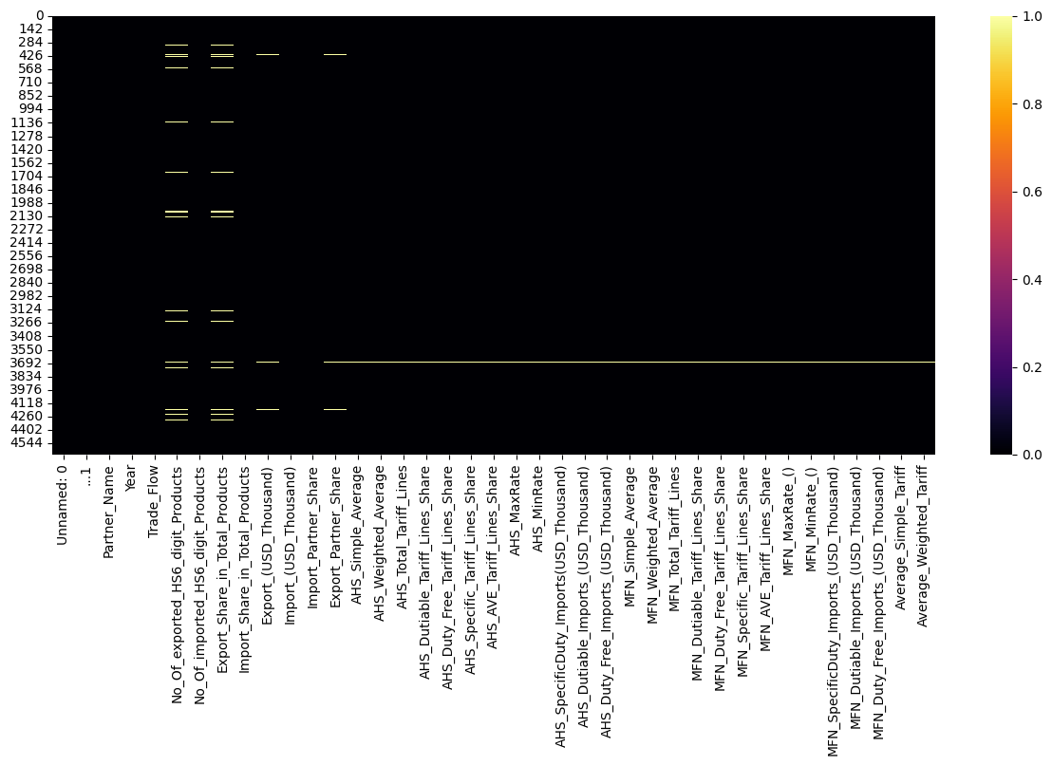
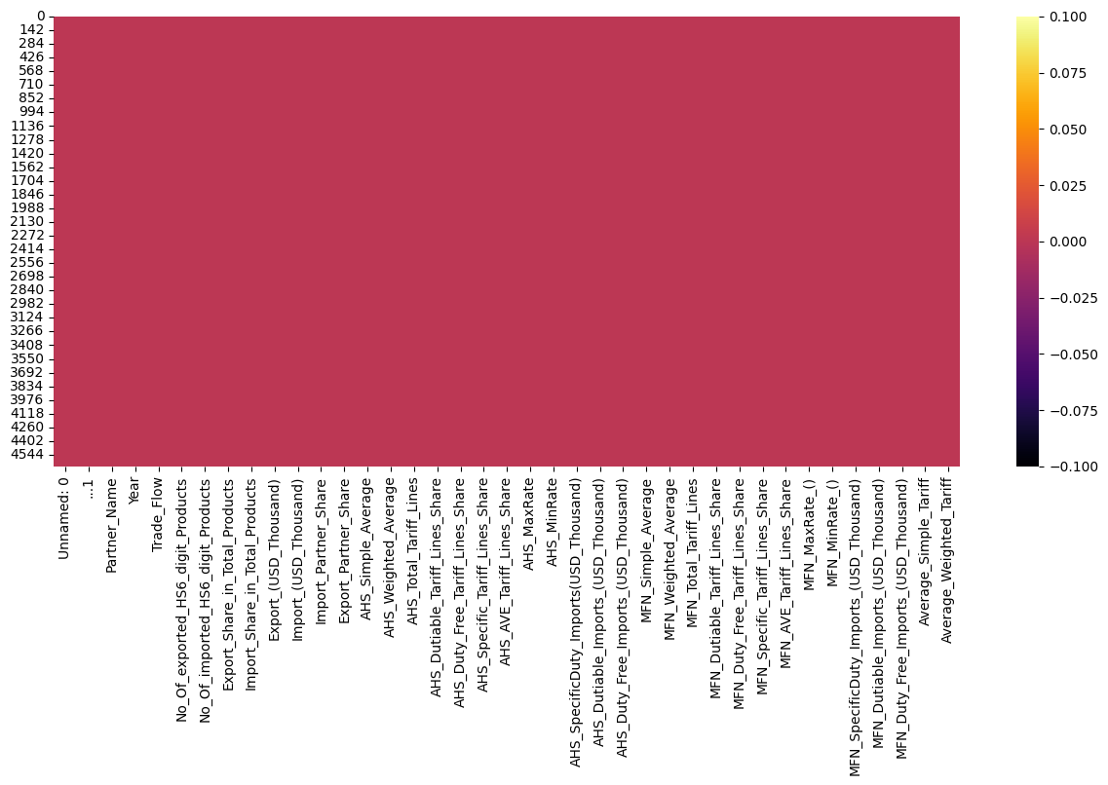
Data Preparation Methods
Before NULL value removal
After NULL value removal
Checked for duplicate rows - 0.0%
Checked for null fields - 418 fields had null values
Removed variables AHS_MinRate (Minimum AHS Tariff Rate) and MFN_MinRate (Minimum MFN Tariff Rate) variables as all values in columns are 0.
Converted NULL fields to numeric value “0”

Slide 15
Exploratory Analysis

Slide 16
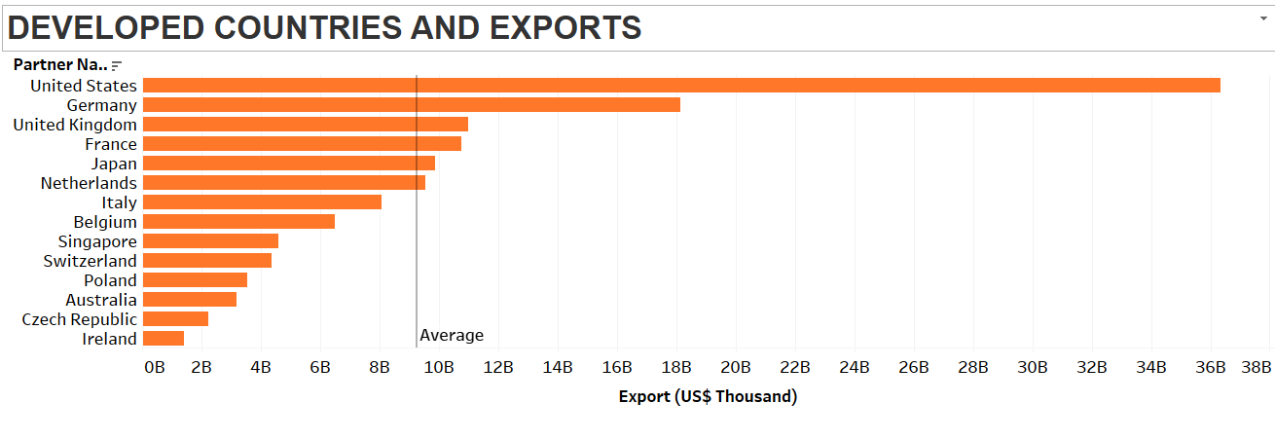
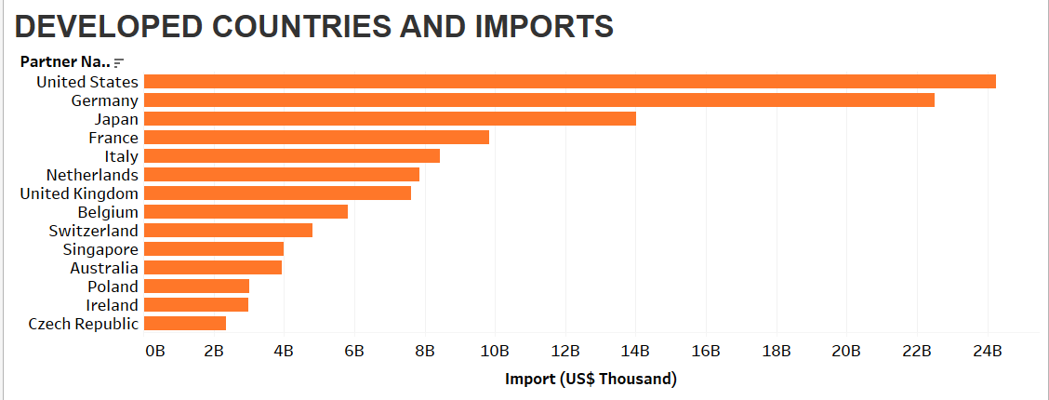
Cumulative Export and Import Values over 20 years - Developed Countries
The US dominates exports, with values nearly double Germany's over the past two decades.
Due to the diverse advanced economy, large consumer market, US remains to be the highest exporter.
50% of the country's’ imports are above the average line discovered through the data.
Ireland's concentration in high-tech and pharmaceutical industries limits its export diversity, which can impact overall export volumes.
The US narrowly edges out Germany in imports, leading by roughly $2 billion.
They are followed by Japan and France.
Czech republic is at the bottom of the list.
Notes:
These are the Exports and imports of Developed Countries for over 20 years. When we look at exports United states is at the top followed by germany, US dominates the exports of developed countries with values nearly double that of germany. It exports things like machinery, chemicals, agricultural products and so on. When it comes to imports USA is still at the top of the list followed by germany, japan and France.

Slide 17
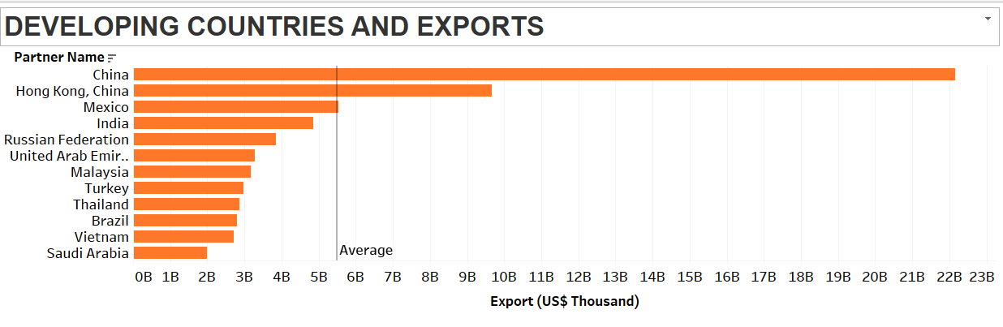
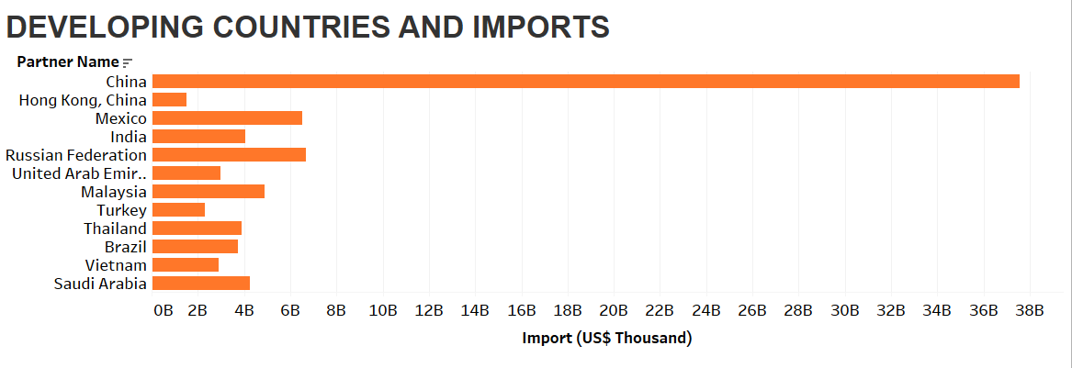
Cumulative Export and Import Values over 20 years - Developing Countries
China undoubtedly remains the lead competitor along with Hong Kong.
About 80% of the countries fall below the average exports of the data
China continues to be the world's largest importer as the products it imports are in different types.
Other countries thrive to be the best but focus on specific trade products. (oil, minerals.)
Notes:
Coming to Developing countries, China is at the top of the list for exports as it exports things like toys, electronics, smartphones, computer parts. China is followed by Hong Kong which is a special administrative region in China, followed by Mexico and India. When it comes to imports China still remains at the top of the list dominating the rest of the developing countries in the imports field. One thing to take note of is saudi arabia, despite being one of the largest oil producers is at the bottom of the list for exports and imports of developing countries.

Slide 18
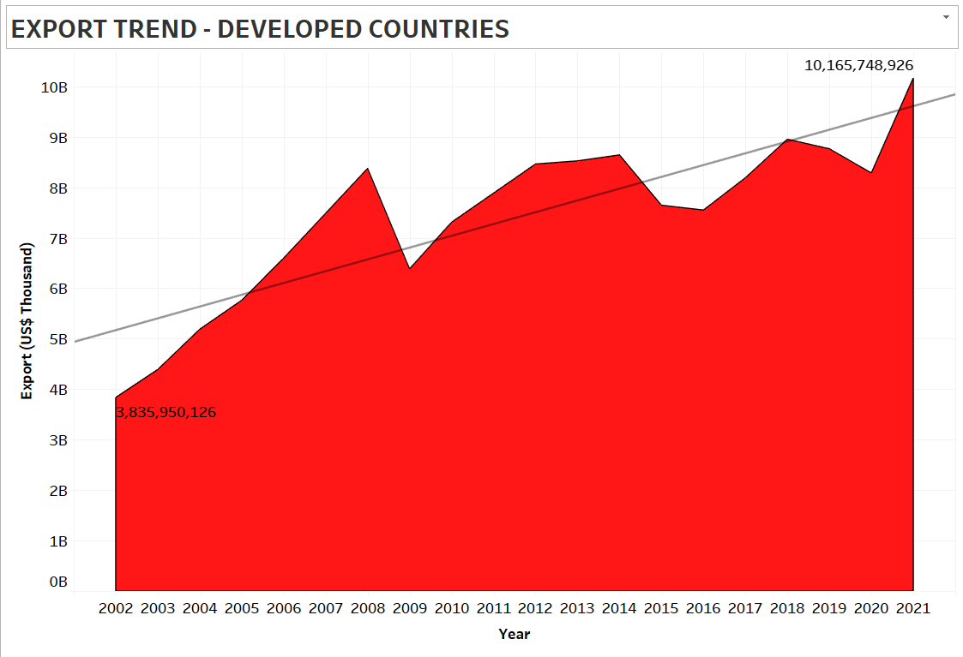
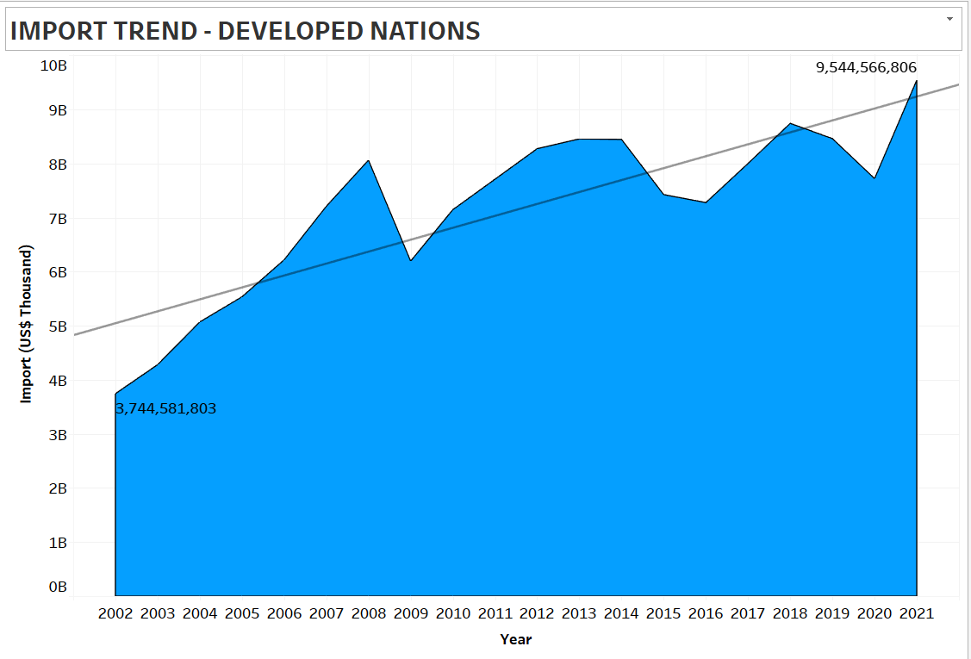
Import & Export Value Trend over 20 years - Developed Countries
Peak is observed in 2008 due to the immense growth in the world’s economy.
Shortly after the peak we can see a drop in Export trend of developing countries. Mainly related to recession. Though, it started pumping back in the year 2010 and a stable growth can be observed.
Imports grew significantly from 2002 to 2008 but dropped in 2009 due to the global economic slowdown. Recovery was evident in 2010, aligning with export trends.
A slight fall in imports could be seen in 2019 due to Covid. A similar recovery like 2010 can be seen in the year 2021

Slide 19
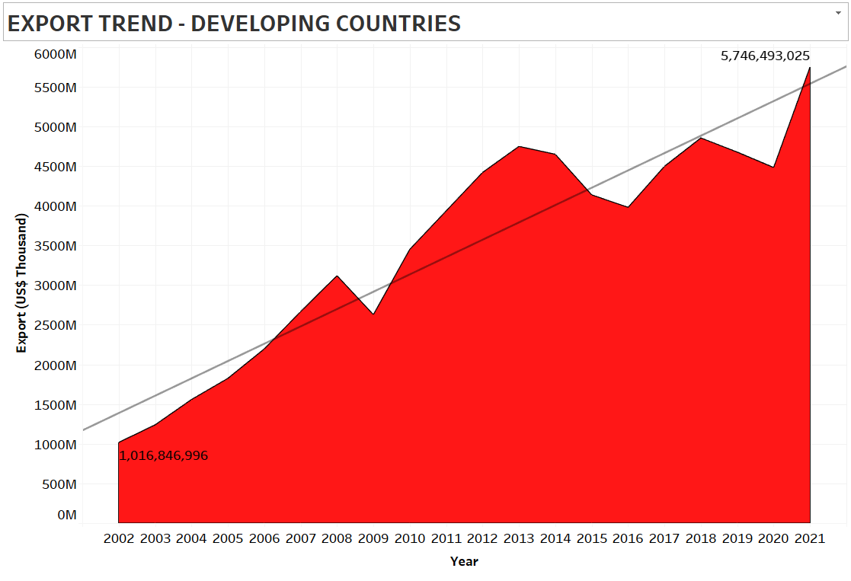
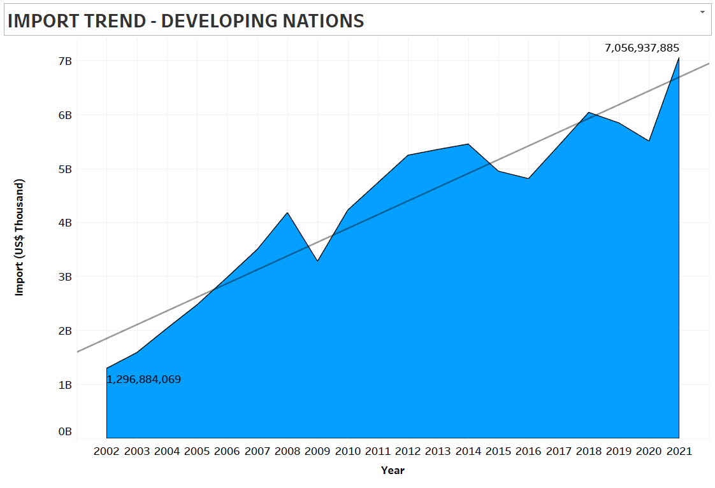
Import & Export Value Trend over 20 years - Developing Countries
In 2009, The recession slowed global trade due to reduced spending and investment, particularly affecting exports from developing nations.
In 2018, Trade policies, tariff reductions and currency fluctuation made imports more accessible and affordable by lowering trade barriers and costs for developing countries.

Slide 20
Modelling Methods

Slide 21
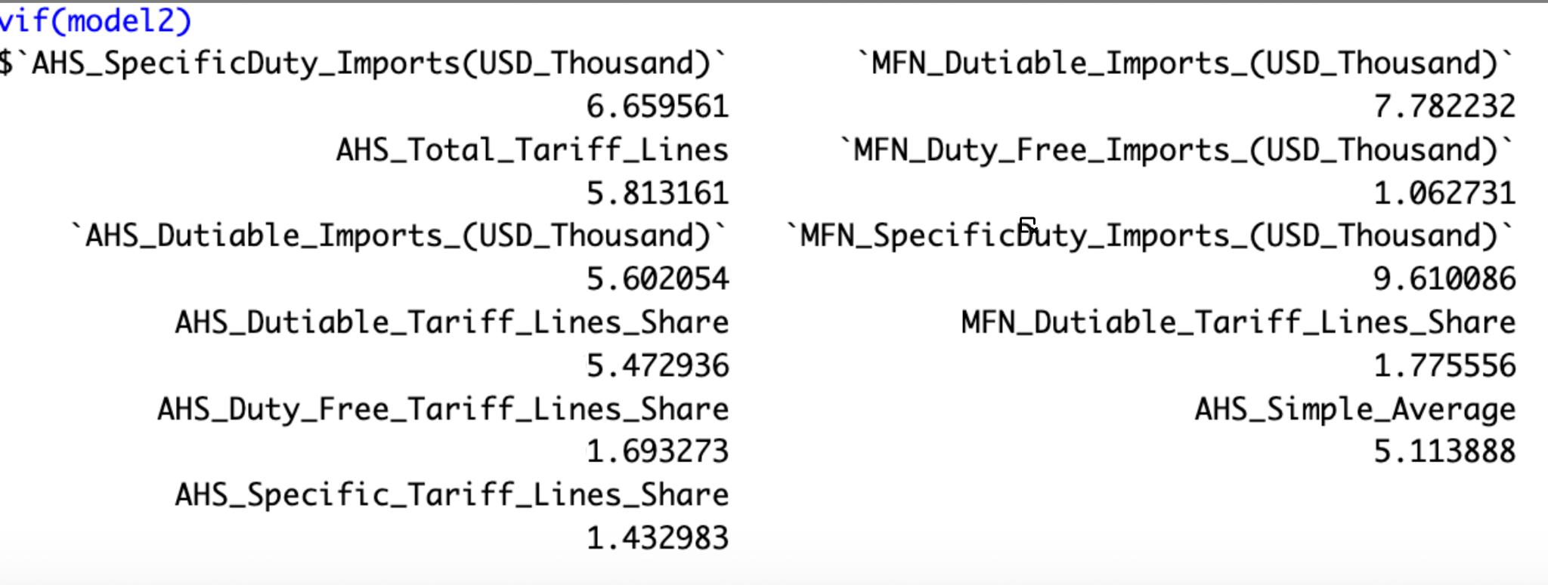
Feature Selection
To find the most important variables that influence Export and Import value in US dollars, we ran multiple tests on the dataset:
1. Forward Selection
2. Backward Elimination
3. Ridge Regression
4. Lasso Regression
5. Recursive Feature Elimination Rankings
6. Feature Importance Using Random Forest
7. Feature Importance Using XGBoost
8. Using the aforementioned test results, 11 Variables were found to be most significant. We then ran a VIF Test for correlation on these variables.
Notes:
Since vif<10 there is no high collinearity in the models predictors

Slide 22
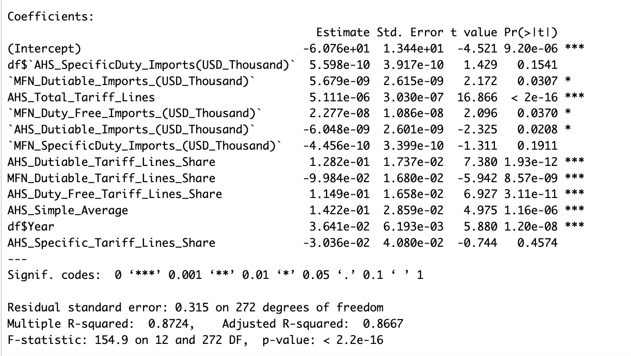
Regression Model for Export - DEVELOPED NATIONS
The model effectively captures 86.7% of export value changes (R²=0.8667).
More tariff lines (AHS_Total_Tariff_Lines) and a higher share of dutiable tariffs (AHS_Dutiable_Tariff_Lines_Share) significantly boost export growth (positive correlation).
Duty-free share (MFN_Dutiable_Tariff_Lines_Share) has the opposite effect (negative correlation).
Year (df$Year) also significantly influences export value changes.

Slide 23
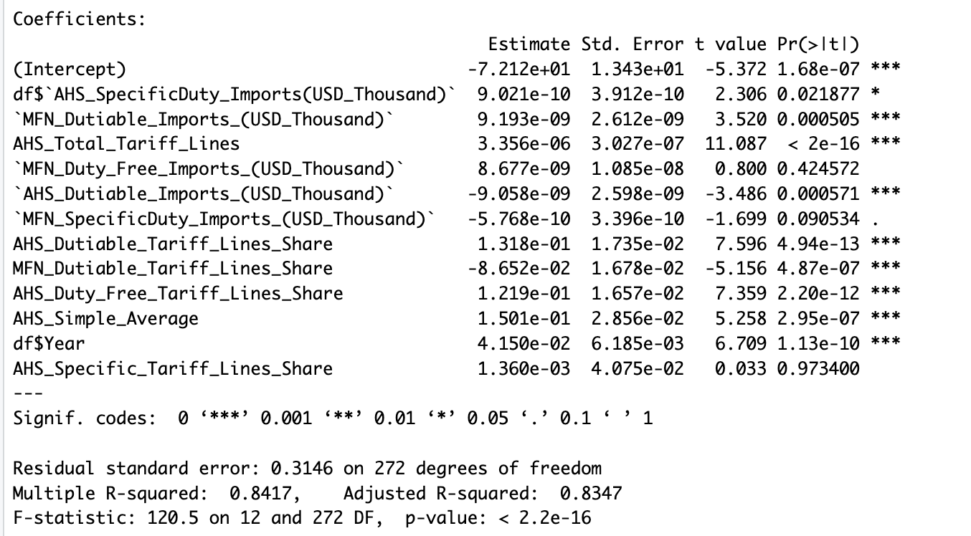
Regression Model for Import - DEVELOPED NATIONS
The model explains 84% of import value variation (R-squared).
Import value increases with specific duties, most favored nation (MFN) dutiable imports, total tariff lines, and simple average tariff.
Duty-free MFN imports and a higher share of MFN dutiable tariffs decrease import value.
Import value shows a positive trend over time.
Share of specific tariffs and MNF Duty-free Imports have no significant effect.

Slide 24
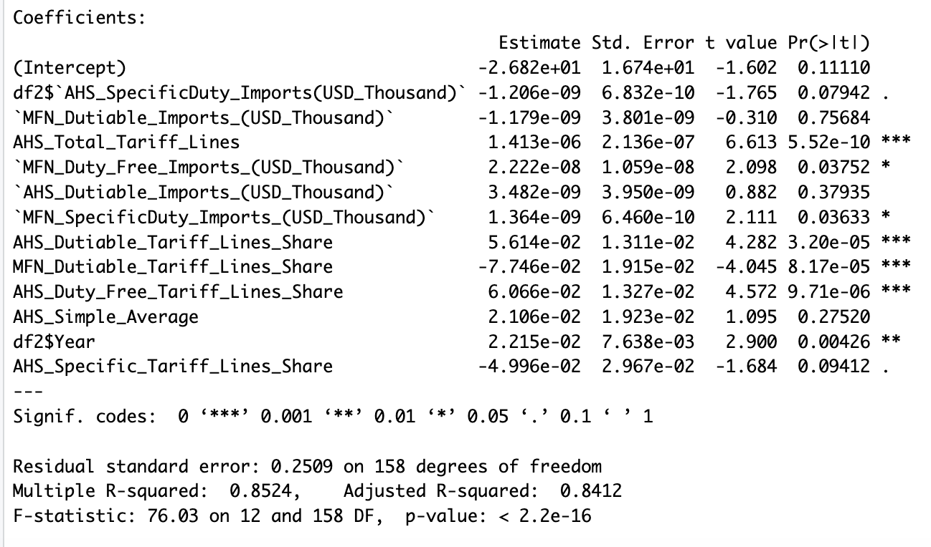
Regression Model for Export - DEVELOPING NATIONS
Explains 84.1% of export value variation (R²=0.8412).
More total tariff lines (AHS_Total_Tariff_Lines) and duty-free share (AHS_Duty_Free_Tariff_Lines_Share) boost exports (positive coefficients).
Conversely, MFN dutiable share (MFN_Dutiable_Tariff_Lines_Share) and specific duties (AHS_SpecificDuty_Imports) hinder them (negative coefficients).
Simple average tariff (AHS_Simple_Average) and year (df2$Year) also positively correlate with export growth.
Notes:
Our analysis shows that our model explains 84.1% of the variation in export values. Factors like having more total tariff lines and a higher share of duty-free tariff lines boost exports, while a higher share of dutiable tariff lines and specific duties hinder them. Additionally, lower average tariff rates and increasing years positively correlate with export growth.

Slide 25
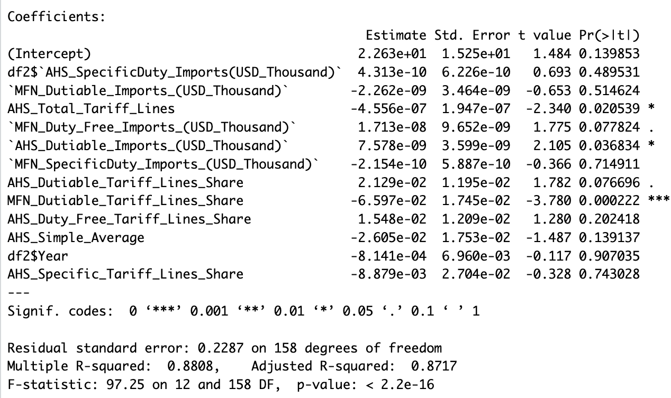
Regression Model for Import - DEVELOPING NATIONS
Explains 87.2% of import value change (R²=0.8717).
More total tariff lines (AHS_Total_Tariff_Lines) and duty-free imports (MFN_Duty_Free_Imports) boost imports (positive coefficients).
Conversely, specific duties (AHS_SpecificDuty_Imports) and a higher share of dutiable tariffs (AHS_Dutiable_Tariff_Lines_Share) decrease imports (negative coefficients). MFN dutiable imports (MFN_Dutiable_Imports) also have a negative impact, but the effect is very small.
Notes:
Our analysis explains 87.2% of the change in import values (Adjusted R²=0.8717). Factors like having more total tariff lines and a higher share of duty-free imports boost imports, indicated by positive coefficients. Conversely, specific duties and a higher share of dutiable tariffs decrease imports, shown by negative coefficients. The impact of MFN dutiable imports is also negative but relatively small.

Slide 26
Key Findings & Insights

Slide 27
Key Findings - Developed Countries
1. Tariff Lines and Duties:
Developed countries like the United States and members of the European Union often have intricate trade agreements with numerous tariff lines. For instance, the EU's Common External Tariff consists of thousands of tariff lines covering various goods.
The positive correlation between tariff lines and trade values reflects the complexity of these trade agreements and the high volume of trade they facilitate.
2. Most Favored Nation (MFN) Duties:
Increases in MFN dutiable imports are associated with higher import values in developed countries (Model 2), while they are associated with lower export values in developing countries (Model 3). This indicates that MFN duties may play a different role in trade dynamics between developed and developing nations.
In developed countries, such as Japan and Germany, increases in MFN dutiable imports may signify greater demand for raw materials and intermediate goods used in advanced manufacturing processes.
However, these countries might impose higher duties on certain imported goods to protect domestic industries, which impacts export competitiveness in certain sectors.
3. Year Trend:
The positive trend in trade values over time for developed countries observed aligns with the ongoing globalization and advancements in technology and transportation, which have facilitated increased trade flows. For instance, the proliferation of e-commerce platforms has made it easier for developed countries to access global markets, contributing to the growth in both export and import values.
Notes:
1. **Tariff Lines and Duties**:
Developed countries like the United States and the European Union have extensive trade agreements with many tariff lines, leading to increased trade. The positive correlation between tariff lines and trade values reflects the complexity of these trade agreements and the high volume of trade they facilitate.
2. **Most Favored Nation (MFN) Duties**:
In developed countries like Japan and Germany, higher MFN dutiable imports reflect increased demand for manufacturing materials. However, higher import duties impact export competitiveness in certain sectors.
3. **Year Trend**:
Trade values in developed countries have been rising over time due to globalization and e-commerce, making global trade more accessible.

Slide 28
Key Findings - Developing Countries
1. Tariff Lines and Duties:
Developing countries like Brazil and India often have complex tariff structures aimed at protecting domestic industries and promoting economic development.
However, the negative impact of dutiable tariff lines on export values in developing countries indicate challenges faced by exporters due to higher tariffs on inputs or finished goods, limiting their competitiveness in global markets.
This discourages exporters thereby leading to a rise in the cost of goods, ultimately contributing to inflation within these nations.
2. Most Favored Nation (MFN) Duties:
In developing countries like Vietnam, increases in MFN dutiable imports might reflect their reliance on imported raw materials and machinery for industrial production.
However, higher MFN duties imposed by trading partners could hinder their export competitiveness, particularly in labor-intensive industries like textiles and apparel.
3. Year Trend:
Developing countries have experienced significant growth in trade values over time, driven by factors such as economic liberalization, foreign investment, and participation in global value chains. For instance, China's rapid economic growth over the past few decades has been accompanied by a surge in both exports and imports, reflecting its integration into global trade networks.
Notes:
Tariff Lines and Duties:
India and Brazil have complex tariff structures aimed at protecting domestic industries and homegrown products to promote economic development in the regions
The negative impact of dutiable tariff lines on % change in export value is an indication of the challenges faced by exporters due to the higher tariff prices on finished goods thereby hindering their position in the global markets which discourages exporters leading to a rise in the costs of the goods and inevitably causes inflation within these nations
MFN:
Vietnam, increases in MFN dutiable indicate an prominent reliance on imported raw materials and machinery
But higher MFN duties from the trading partners tamper with their export competitiveness, especially in labor-heavy industries like textiles and clothing
Year Trend:
Countries in the developing category have seen a significant growth over the last two decades driven by economic liberalization, foreign investments and global participation. One country that has seen tremendous growth is china over the past few decades built on the surges in exports and imports as a result of it integrating itself into the global trade network

Slide 29
General Insights
By understanding the likely impacts of various approaches, policymakers can formulate more effective strategies to achieve their economic goals. This means they can plan for problems, find chances to grow, and make sure everyone benefits from trade:
Trade Expansion: Policies that aim to increase a country's overall trade volume, potentially leading to economic growth through increased exports and access to a wider variety of imports.
Import Substitution: Strategies that focus on reducing a country's reliance on imports by encouraging domestic production of certain goods.
One-size-fits-all strategy is inadequate in addressing the diverse needs and challenges encountered by nations within the global trading framework.
Nuanced policies need to be crafted with precision to bolster their participation in international trade while safeguarding their domestic interests.
Developed vs. Developing Countries: Developed economies with established industries might prioritize free trade agreements to expand markets and increase their export value. Developing countries, on the other hand, might use protectionist measures like tariffs to shield nascent industries and promote domestic production.
By doing this, they can create plans that not only make their economy better but also make sure everyone has a fair shot at success.
Notes:
Policymakers can leverage this information to create effective strategies which will enable them to prep, plan for and mitigate problems and find opportunities for growth. Trade Expansion through increased exports and access to a wider variety of imports is one such benefit that can be considered.
Import substitution by encouraging home-grown products will help move away from the reliance on imported goods.

Slide 30
Conclusion

Slide 31
Recommendations
Encourage Trade Agreements: To mitigate the negative impacts of trade wars and promote stable trade relations, countries should consider engaging more in bilateral and multilateral trade agreements.
Focus on Competitive Advantages: Countries should tailor their tariff structures to bolster industries where they have a competitive advantage, thus maximizing economic benefits while minimizing the adverse effects on consumer prices and market competition.
Invest in Trade Facilitation: Improving administrative procedures, enhancing trade infrastructure, and investing in technology can help countries reduce the overall costs associated with tariffs and trade barriers, making them more competitive in the global market.
Monitor and Adapt: Continuous monitoring of the effects of tariffs on the economy should be maintained, with adaptive measures ready to be implemented as global economic conditions evolve.
Notes:
1. **Encourage Trade Agreements:**
- fostering stable trade relations through bilateral and multilateral trade agreements can help prevent damaging trade wars and provide a framework for resolving disputes peacefully.
- European Union (EU) - multilateral trade agreement - where member countries benefit from stable trade relations and a single market.
- North American Free Trade Agreement (NAFTA) - trade between United States, Canada, and Mexico - boosting economic growth and job creation in all three countries.
2. Focus on Competitive Advantages:
- Explain the concept of competitive advantage and how it influences a country's economic success in global trade.
- Use Germany - leveraged its competitive advantage in manufacturing, particularly automobiles and machinery, to become a global export powerhouse.
- Japan's strategic tariff policies that support industries like electronics and automotive, enabling the country to maintain its position as a leader in these sectors while ensuring fair competition.
3. **Invest in Trade Facilitation:**
- streamlining administrative processes and improving trade infrastructure to reduce the costs associated with tariffs and trade barriers.
- Singapore's investment in state-of-the-art port infrastructure and digital trade platforms, which have transformed it into one of the world's busiest and most efficient trading hubs.
- United Arab Emirates (UAE) in developing world-class logistics facilities and adopting advanced customs procedures, attracting significant trade volumes and foreign investment.
4. Monitor and Adapt:
China's response to changing global trade dynamics, where the government continuously adjusts tariffs and trade policies to mitigate economic risks and support domestic industries.
United States' flexibility in trade negotiations, such as renegotiating trade deals like NAFTA to address emerging challenges and opportunities in the global market.

Slide 32
Final Statement
Significant Impact of Tariffs: The analysis shows that tariffs have a substantial influence on both import and export values across developed and developing countries. This aligns with the historical perspective that tariffs can drive economic behaviors and reshape trade dynamics.
Complex Trade Structures: Developed countries with intricate tariff lines tend to experience higher trade volumes, suggesting that complex trade structures can facilitate or hinder trade depending on how they are managed.
Diverse Effects on Trade: While tariffs generally protect domestic industries, they can also lead to trade diversion, impacting global supply chains and competitive dynamics. This has been particularly noticeable in the case studies of developed versus developing countries.
Economic Growth and Trade Policy: The study underscores the correlation between tariff policies and economic growth, highlighting that thoughtful trade policy is crucial for maintaining healthy economic dynamics.
Notes:
Tariffs profoundly affect global trade, shaping import and export values in both developed and developing nations. Historical evidence supports their significant impact on economic behavior and trade patterns.
Complex tariff structures in developed countries correlate with higher trade volumes, showcasing how trade intricacies can either facilitate or impede trade flow based on effective management.
Tariffs, while shielding domestic industries, can also divert trade, disrupting global supply chains and competitive landscapes, especially evident in comparisons between developed and developing economies.
The study emphasizes the critical link between tariff policies and economic growth, stressing the necessity for thoughtful trade strategies to sustain healthy economic development.

Slide 33
Thank You

